Slide 1
FACEBOOK RE-DESIGN:
openDoor Social Networking Concept
William “Chris” Ray

Slide 2
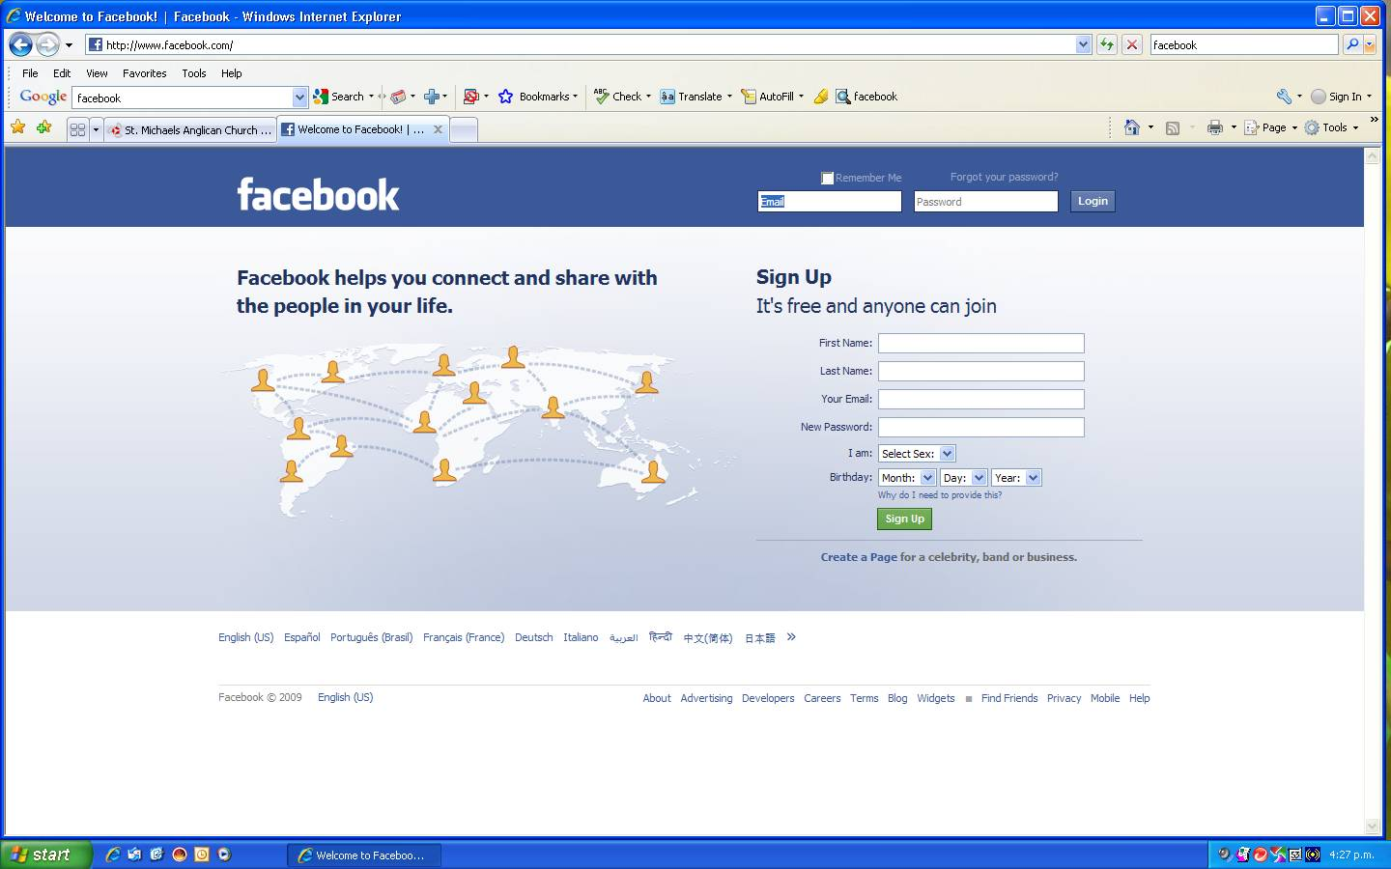
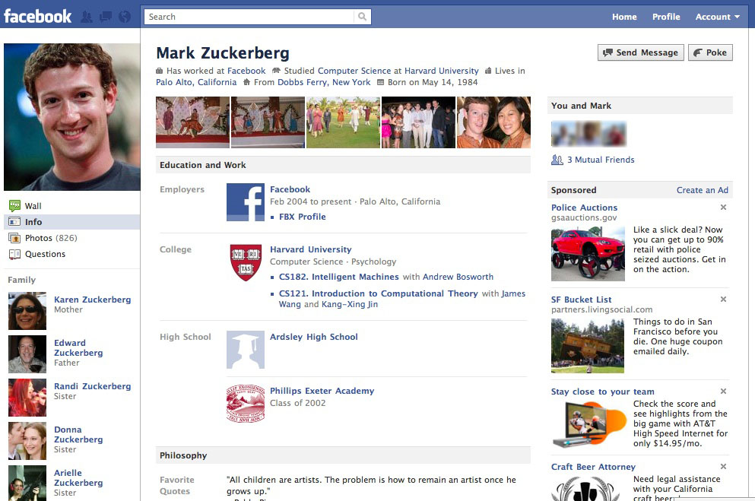
Facebook: Social Standard
Facebook Logon
Facebook Page

Slide 3
Facebook Pros/Cons
Pros:
Centralized Communication – Having your “address book” with all your friends in one location for events, networking, and socializing.
Fluid Interface – Navigation is very fluid from profile to profile for easy access and communication between users.
Integrated with most websites as a way to comment on outside content.

Slide 4
Facebook Pros/Cons
Cons:
Disconnection from the real world both technically and socially – Implied sense of detachment from responsibility of post due to lack of tangible connection to profiles.
Interactivity is, while very fluid, very generic and each profile is very direct and generic.
Privacy issues – this is somewhat related to the disconnection issue in that the need for privacy most often stems from actions perpetuated under this sense of detachment with no real life consequences.

Slide 5
openDOOR Social Network
openDOOR or OD would be a blend between the socializing aspect of Facebook and the pseudo-world type realities of Second-Life and Home for PlayStation.

Slide 6
Top level Login
At the top level there would be a global view of earth in Wire outline of the sphere and continents. On the sphere, there would be a speck of light for each area that is connected with a brighter light for the amount of people in this connection (similar to the way we view artificial light such as car lights, street lights, buildings and homes) from a satellite during nighttime.
When the user logs in he would be confronted with this view positioning all the live doors across the world.
-The example provided is a screen shot of Folding@Home by Playstation.

Slide 7
Second Level Searching
As the user zoomed into an area he would see generic buildings in that area with doors lining each side as if a floating apartment hallway. These would be other profiles whom the user could enter their “room” if they were friends or leave public messages on their door or slide in private mail under the door.
-The example provided is a screen shot of Folding@Home by Playstation. (Zoomed shot of American East Seaboard)

Slide 8
Real World Connection
With use of GPS or at the discretion of users to pick a location rooms would be attached to a specific position with the current user finding other users either through zooming into their position or through visiting a set list of “friends”. This would also add a level of attachment to the real world by showing a none location and linking it to a hard connection to the world.
-Possible use of physical connection to set a door location through GPS and Bonus content if you visit a users physical location via GPS.
-The example provided is a screen shot of Folding@Home by Playstation. (Zoomed shot of American East Seaboard)

Slide 9
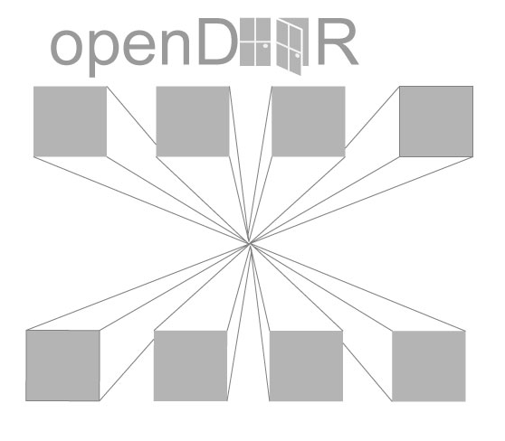
Zoom in to Specific Area
Overhead View of
Room Location Buildings or Nodes

Slide 10
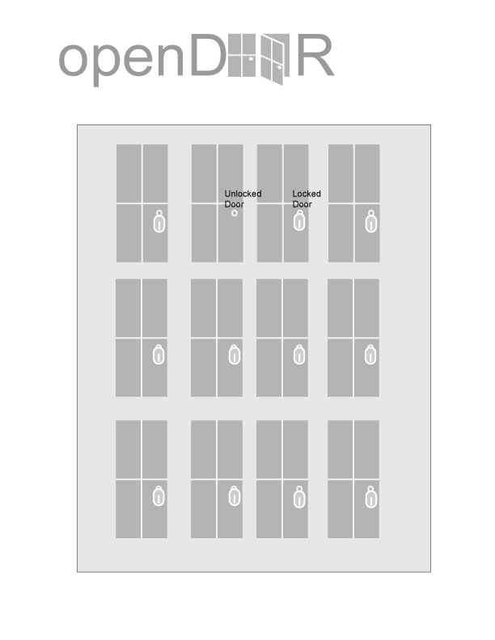
Zoom in to Specific Area
Single Building or Node

Slide 11
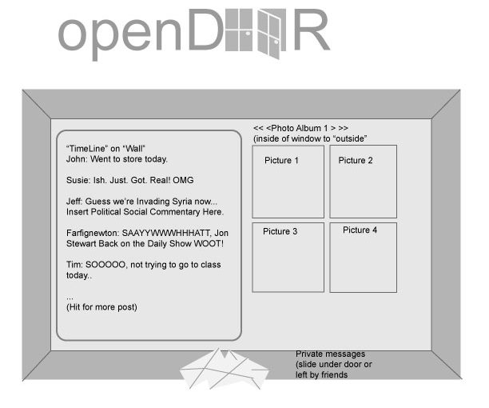
Room View
Room View Showing “wall”, Private Messages, and “window” to pictures.

Slide 12
Questions?
Comments?
Concerns?

