Slide 1
Feedback Loops:
The BuzzKillington Mark 1 – BKM1
Week 5 Major Studio Assignment – William Ray

Slide 2
Feedback Definition:
  Feedback is a process in which information about the past or the present influences the same in the present or future. As part of a chain of cause and effect that forms a circuit or loop, the event is said to "feed back" into itself.
  -Wikipedia

Slide 3
Feedback Definition:
  According to Thomas Goetz, writer of, “Harnessing the Power of Feedback Loops” a feedback loop involves four distinct stages:
    Evidence Stage: Data or a behavior must be measured, captured, and stored.
    Relevance Stage: The information gathered must be relayed to the individual in a context that makes it emotionally resonant.
    Consequence Stage: The information must illuminate one or more paths ahead by comparison to implied negative results.
    Action Stage: There must be a clear moment when the individual can re-calibrate a behavior, make a choice, and act (HOPEFULLY, to avoid negative results).

Slide 4
Feedback Loop Target:
Playstation 3 and Other Gaming or Computational Devices used for Entertainment.
Problem: Time Management – Overheating

Slide 5
Feedback Loop Target:
Playstation 3 and Other Gaming or Computational Devices used for Entertainment.
Problem: Time Management – Overheating

Slide 6
Feedback Loop Target:
Playstation 3 and Other Gaming or Computational Devices used for Entertainment.
Problem: Time Management – Overheating

Slide 7
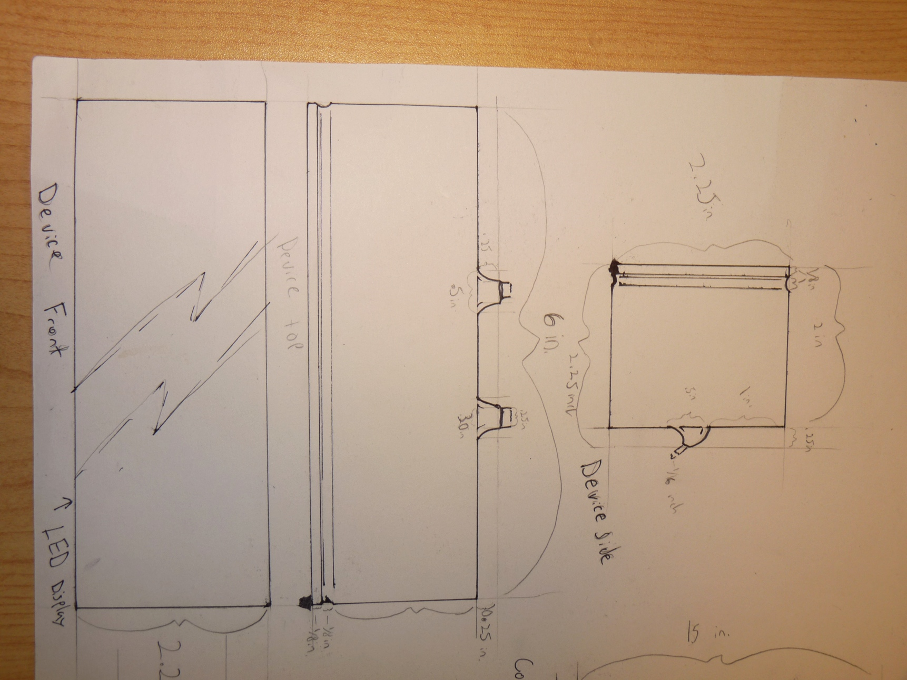
BuzzKillington Mark 1 – BKM1
Size Specifications:

Slide 8
Evidence Stage:
Evidence Stage - Target Data
  How long have you been playing?
  How Hot is your Device

Slide 9
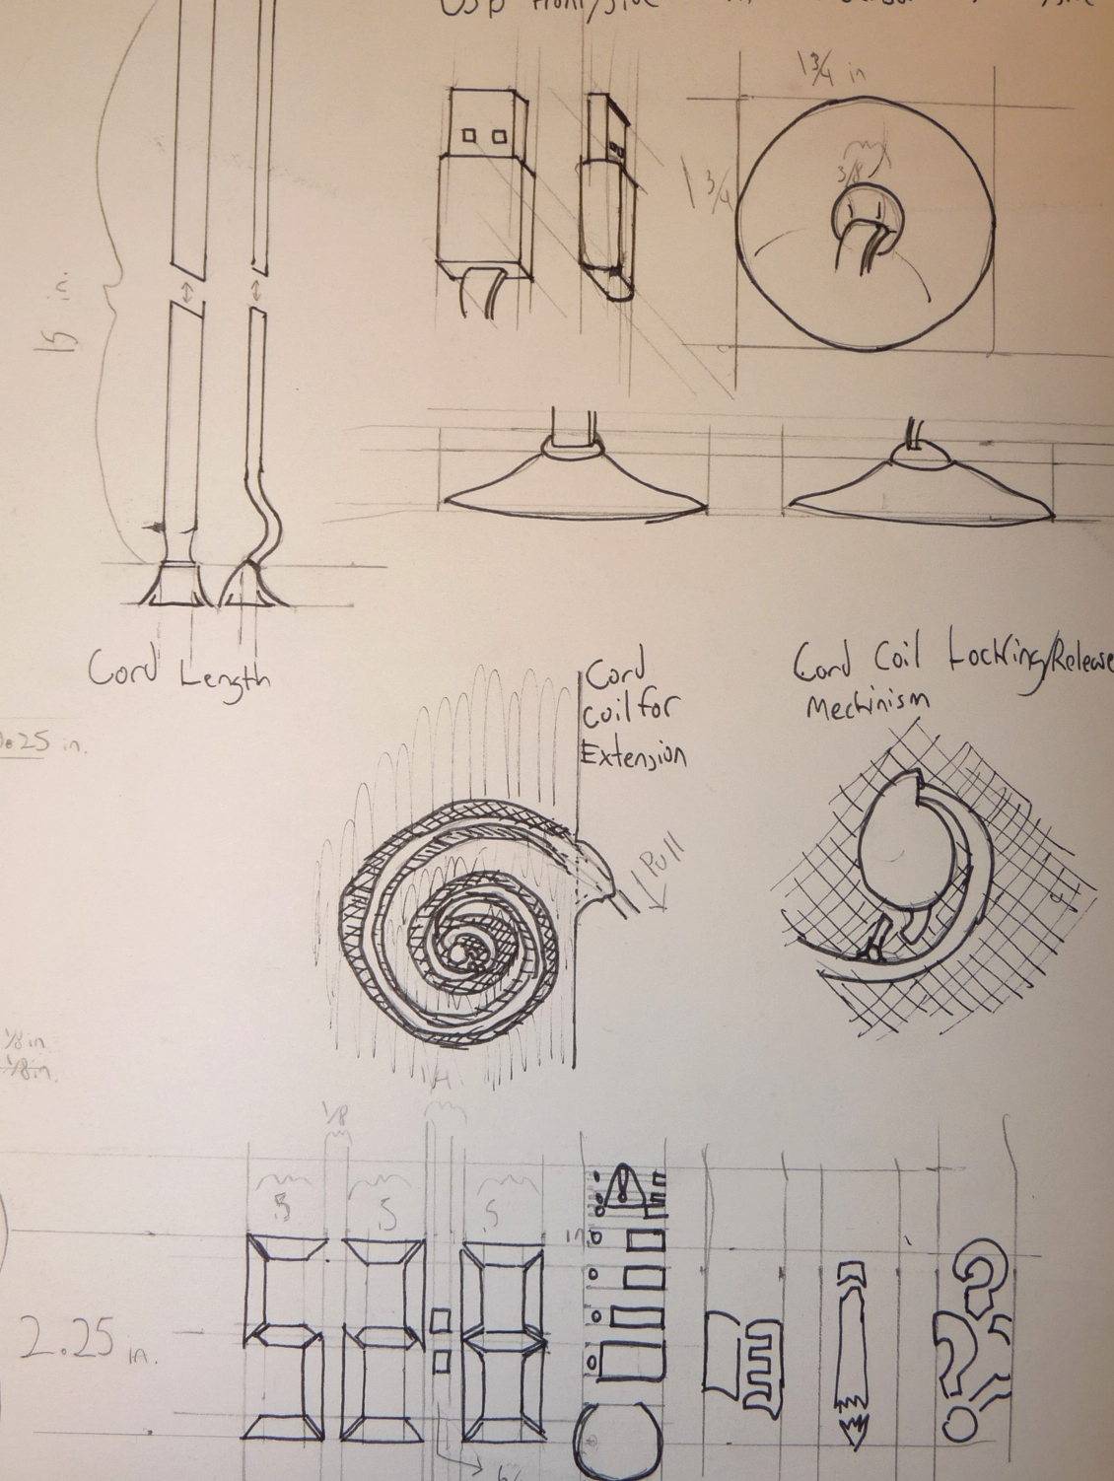
Evidence Collection
Power Source and Data Collection Start at same time
USB Powered: Plugged into the device of choice it begins the ascending
Suction Cup Temperature Monitoring

Slide 10
Relevance Stage:
  Time Management as a student or as a Responsible Person:
    We all know that time management is hard enough in the real world but as a student where there is just enough of free time to “hang yourself with” one could easily loose track of objective time management.
  Device Temperture:
    The PS3's Safety and Support manual says that the operating temperature range is from 5C-35C (41F-95F)

Slide 11
Relevance Stage Aesthetic:
  Designing the BK-M1 to count time in ascending order and with Hours:Minutes:Seconds:Miliseconds counting constantly it allows the user to get a direct and exact count up of time spent in play. For the digits I choice to display them in the old school bar format used for simple alarm clocks to make it clear and comfortable to the user what its for.
  Also, as a graphic, the thermometer and time alternative images display of temperature and simple icons for alternative activities also gives the user a practical relevance
  Finally, the small size and unobtrusiveness of the device compliments the fact that its attached to an entertainment device and doesn’t overpower the media, but still stays relevant.

Slide 12
Consequence Stage:
    Overheating and loss of Electronic Device is a direct consequence.
    Showing what you could have done in that Time is also a direct link to the users usage of time for activities that are “implied” to be more fulfilling. Times are not exact simply because the ability of the user is something that can not be predicted in advance as far as academic ability:
      Every 15 Minutes Comprehensive Reading of two pages in a book. (cummilative)
      Every 30 Minutes Researched and Written One page of an essay. (cummilative)
      Every 60 Minutes What could you do with an hour back?
    As with my assessment of Goetz’s Feedback Loop article, I would like to use this time to assess the psychological ramifications of the Consequence portion of the Feedback Loop stages…

Slide 13
Consequence Stage
Counter Argument:
  Relevance of Play
    Ambiguity of Play by Brian Sutton-Smith makes the argument, in Chapter 11 - Rhetorics of Frivolity, that a common rhetoric about the relevance of playing (video games or other forms) in culture is undermined in western civilization by early protestant and capitalistic political leanings on development of current community socialization methods.
    Jane McGonigal
      How Games can Change the World:
        Through Cooperation
        Through exposure to ideas, leading to Empathy
        Through Longevity

Slide 14
Action Stage:
  Based off the Consequence stage,
  what -should- be the intended actions?

Slide 15
Conclusion:
Questions, Comments, Concerns
Sources:
    Thomas Goetz, Harnessing the Power of Feedback Loops: http://bit.ly/loopfeedback
    Wikipedia Defintion of Feedback: http://en.wikipedia.org/wiki/Feedback
    The PS3's Safety and Support Manual - Packaged with Playstation 3 Hardware.
    Operating Temperture vs System Reliability http://www.pcpower.com/technology/optemps/
    BriNSutton­Smith, The Ambiguity of Play
    http://janemcgonigal.com/

