Slide 1
Statistics in Racial Profiling
And the Automated Race Riot.
William Ray
Major Studio Mashups:
Digital – Digital
Digital – Physical

Slide 2
Raw Data
Stop And Frisk
In 2012, New Yorkers were stopped by the police 532,911 times
473,644 were totally innocent (89 percent).
Racial Breakdown
284,229 were black (55 percent).
165,140 were Latino (32 percent).
50,366 were white (10 percent).
In June Alone over 30,000 Frisk.
On June 17th over 700 Stop and Frisks between the 5 Boroughs From Midnight – 11:59 PM

Slide 3
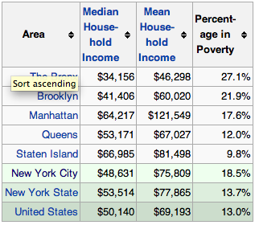
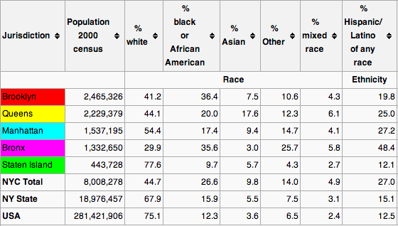
Raw Data
Racial Demographic
Economic Demographic

Slide 4
Map Base

Slide 5
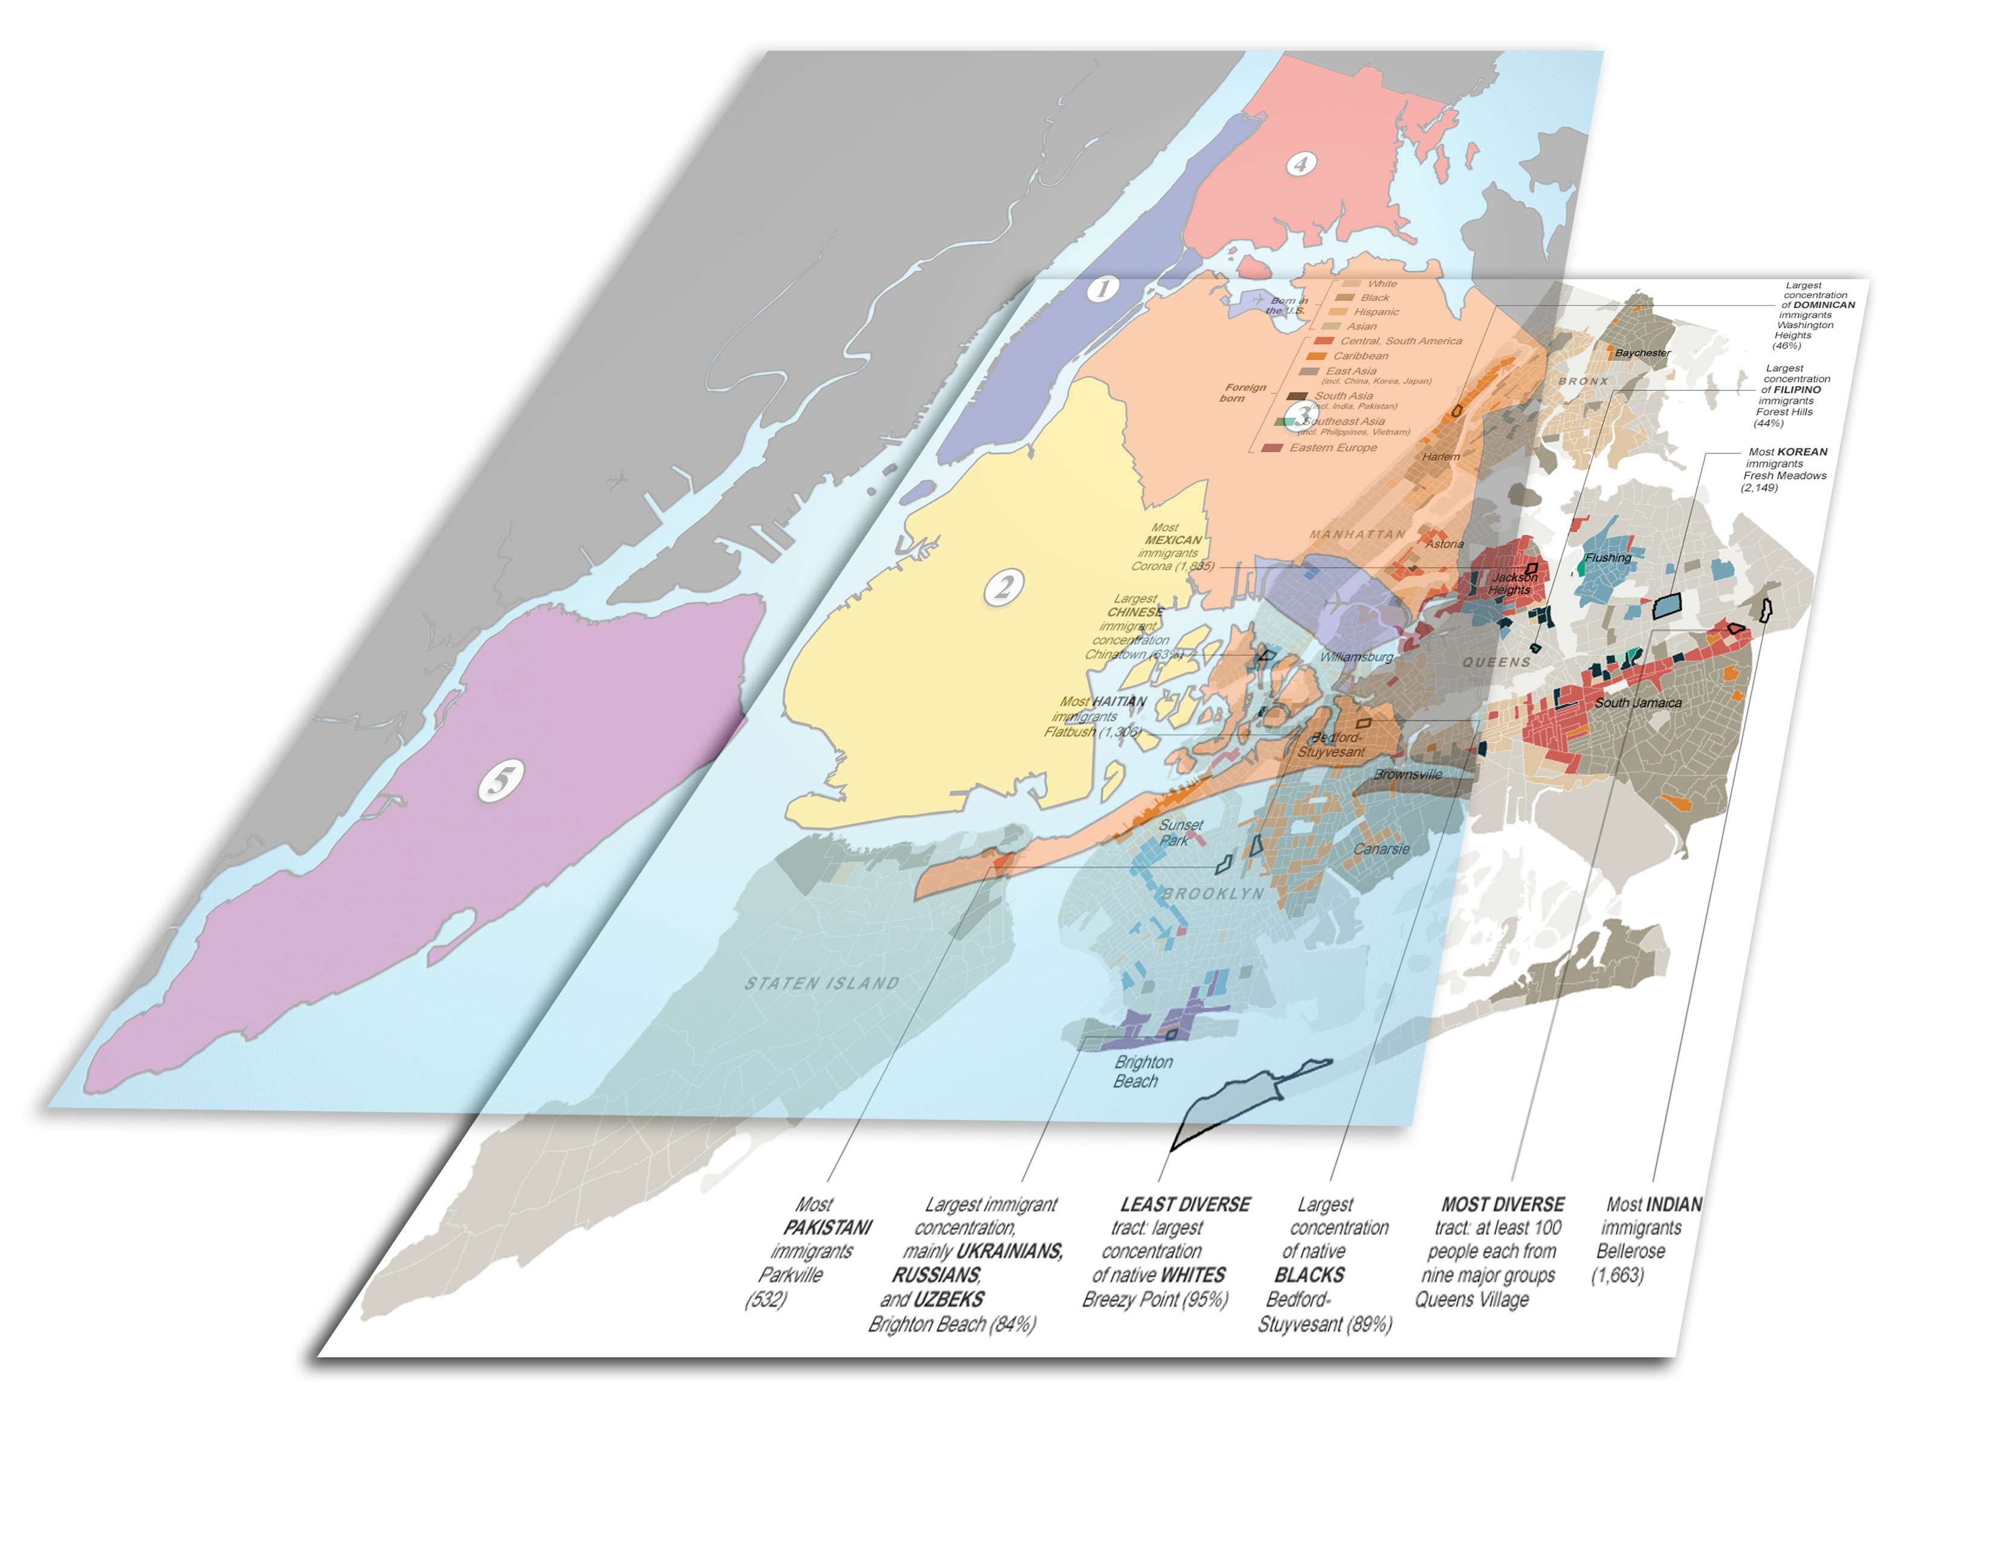
Map Base

Slide 6
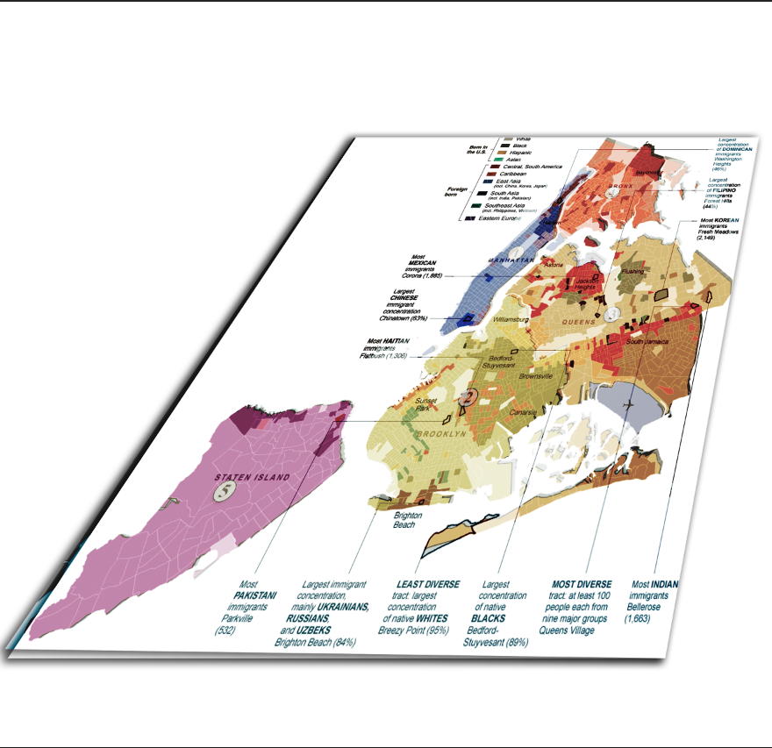
Map Base

Slide 7
Automated Race RIOT
Using both Data sets of Zones racial Demographic and Previous Stop and Frisk data we can see some discriminatory trends.

Slide 8
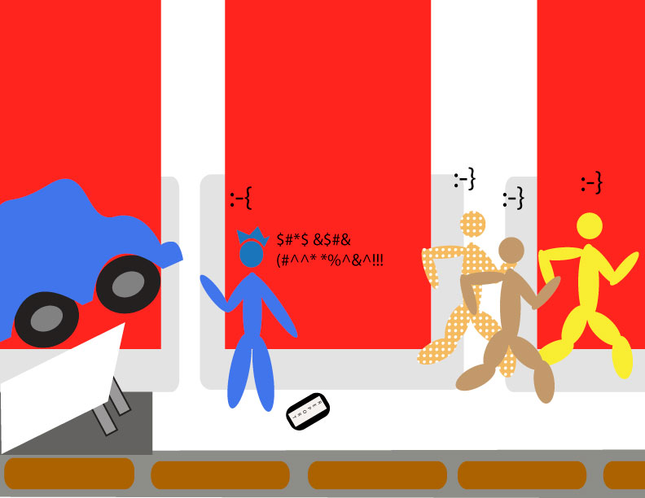
AutomateD Race RIOT
In response to Over targeting of any demographic when cross referencing it to the population base, Automated rioting would begin for the modern age, technologically advanced rioter.

Slide 9
AutomateD Race RIOT
As a precautionary measure, the automated riot systems hopes to minimize damage on both sides. Physical on the rioters side, publicity (by not going back to the 60’s) on the authority side.

Slide 10
Questions, Comments, (and hopefully) Concerns???
Automated Race Riot

Slide 11
Source Page
Stop And Frisk Data
Provided by New York Civil Liberties Union
http://www.nyclu.org/content/stop-and-frisk-data
*** http://www.nyclu.org/app (consider getting the Frisk Watch app., stop racial discrimination)
Borough Map of New York
http://en.wikipedia.org/wiki/New_York_City Boroughs Section
Racial Demographic
Map: New York Times
http://www.nytimes.com/interactive/2011/01/23/nyregion/20110123-nyc-ethnic-neighborhoods-map.html?_r=0
Statistics: Wikipedia – 2000 Census
http://en.wikipedia.org/wiki/Demographics_of_New_York_City
Economic Demographic
http://en.wikipedia.org/wiki/Demographics_of_New_York_City
Info

